Slide 1









AI
Damien, Hongxi and Alex

Slide 2



What Is AI?
Artificial Intelligence: A program or system that mimics human intelligence
Systems that think like humans
Systems that act like humans
Systems that think rationally
Systems that act rationally
Damien

Slide 3
Application of AI
Recommendation engines (google, youtube, twitch, etc.)
Computer vision (image recognition)
Speech recognition
LLMs
NPC in Games
Demos in Games
Damien

Slide 4
AI in Games
Dijkstra’s Algorithm (DYKE-straz this is for me not you (-_-))
Greedy Best-First-Search
A* Pathfinding
Decision tree
Procedural-content generation
Player-experience modeling
Machine Learning/Deep learning AI
Damien

Slide 5

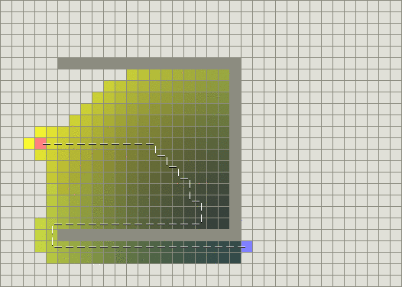
Dijkstra’s Algorithm
Greedy Best-First-Search
Damien

Slide 6
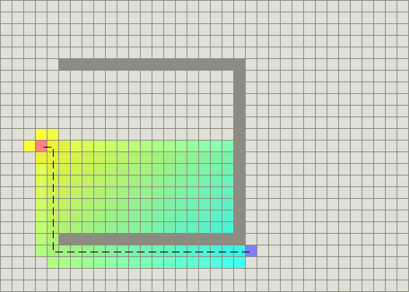
A* Pathfinding
Damien

Slide 7
A*Pathfinding
Uses three things
G: Distance from node to start
H: Distance from node to goal (optimistic approach)
F = G + H “priority” for a node to be picked
For a grid each horizontal and vertical space has a movement value of 1
While the diagonals have a movement value of 1.4 (root 2ish)
Damien

Slide 8
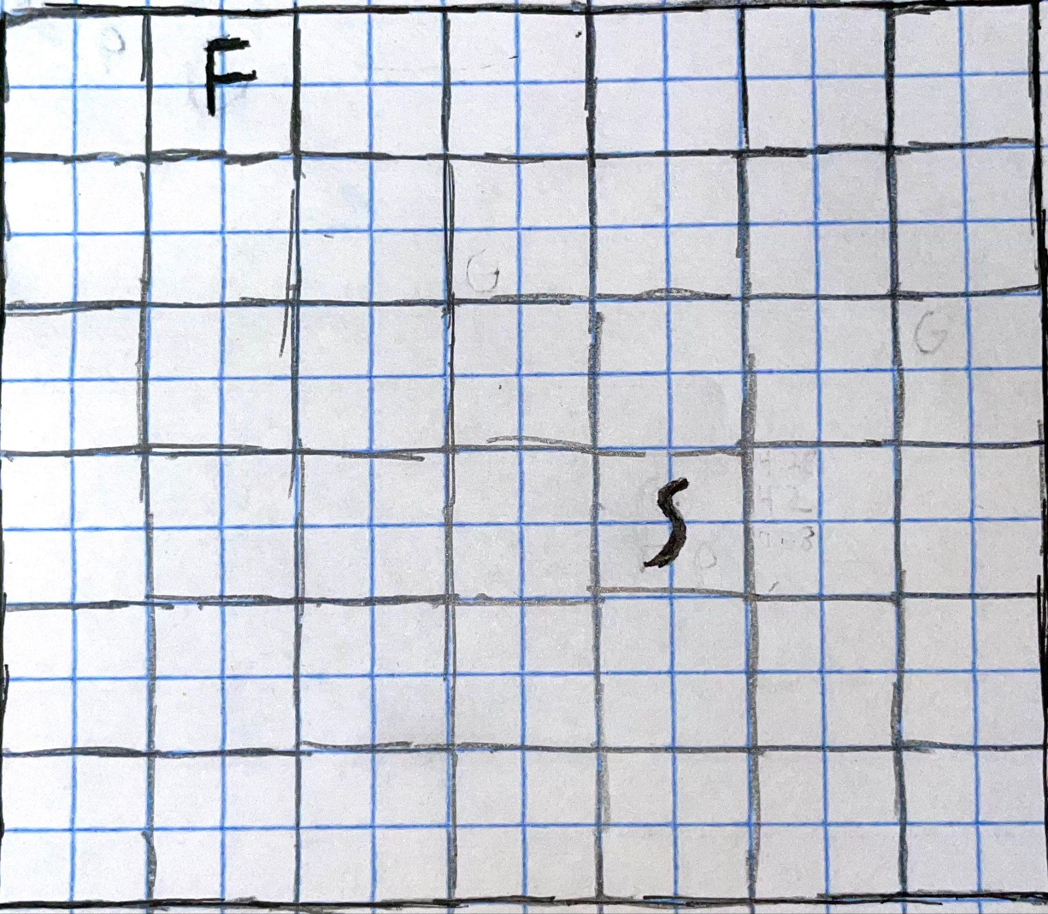
Damien
Damien

Slide 9
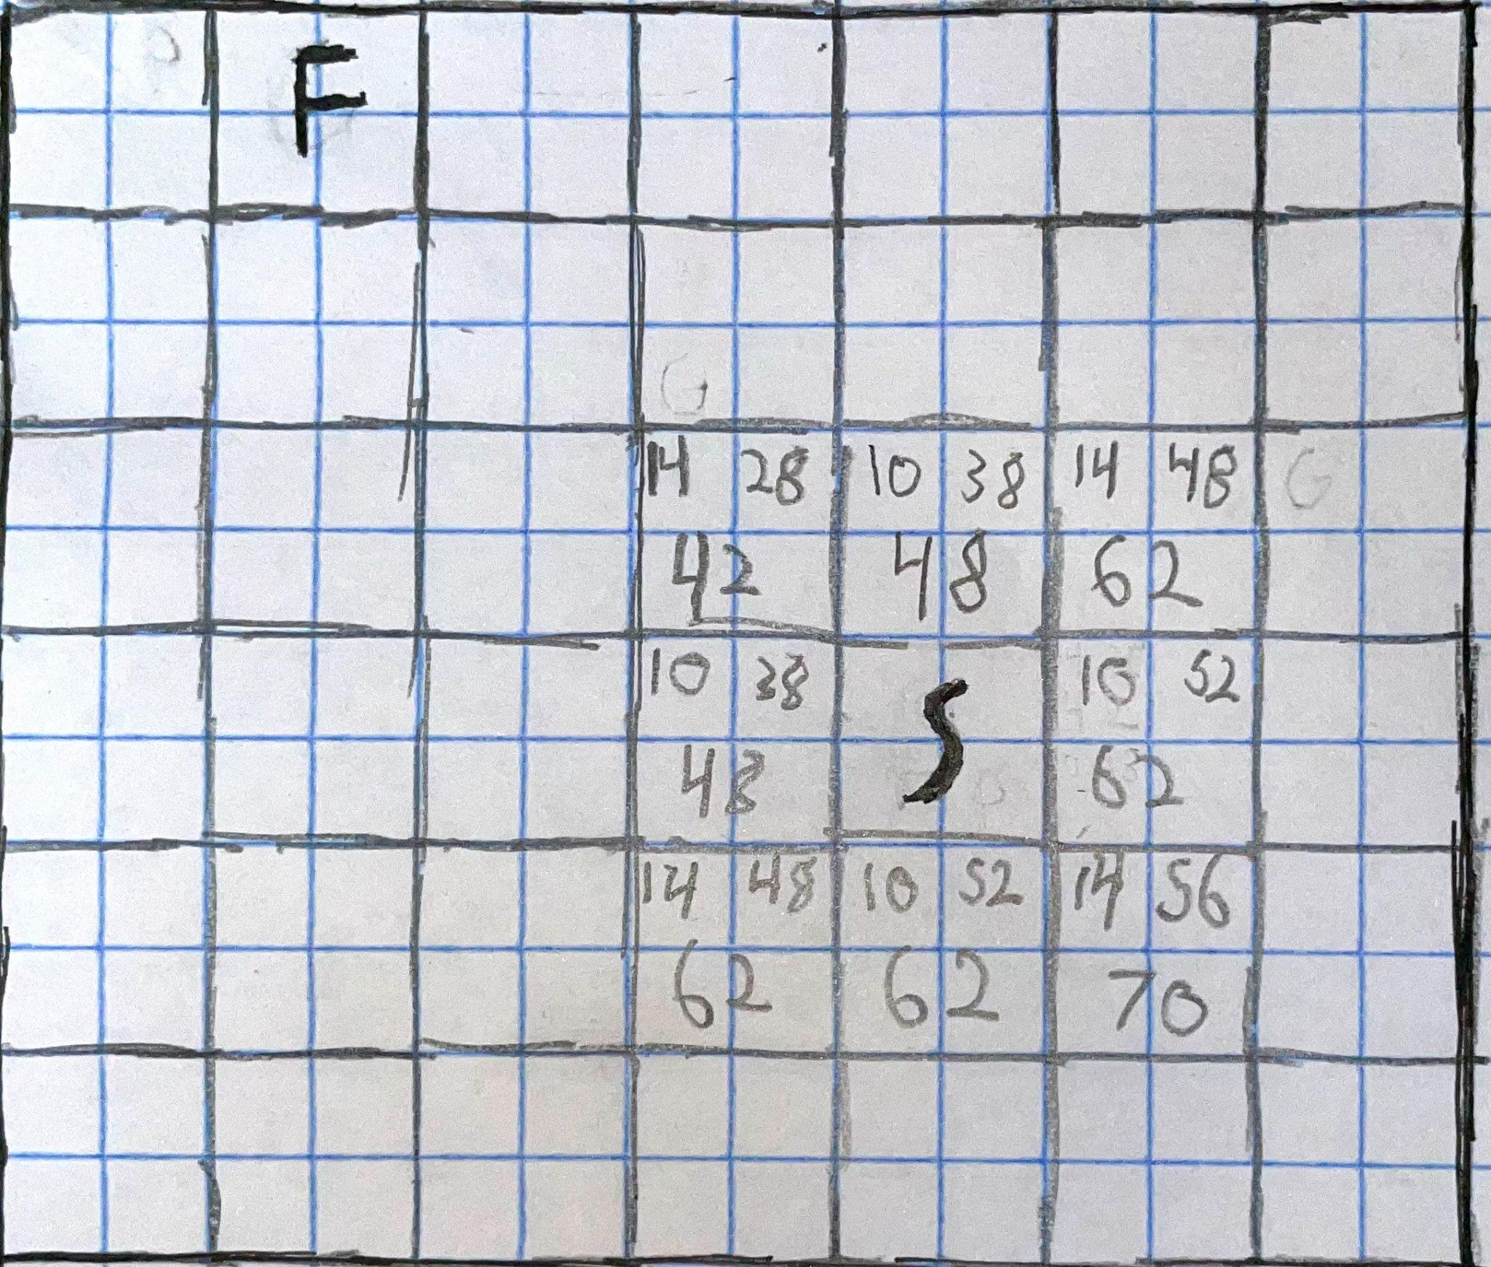
Damien

Slide 10
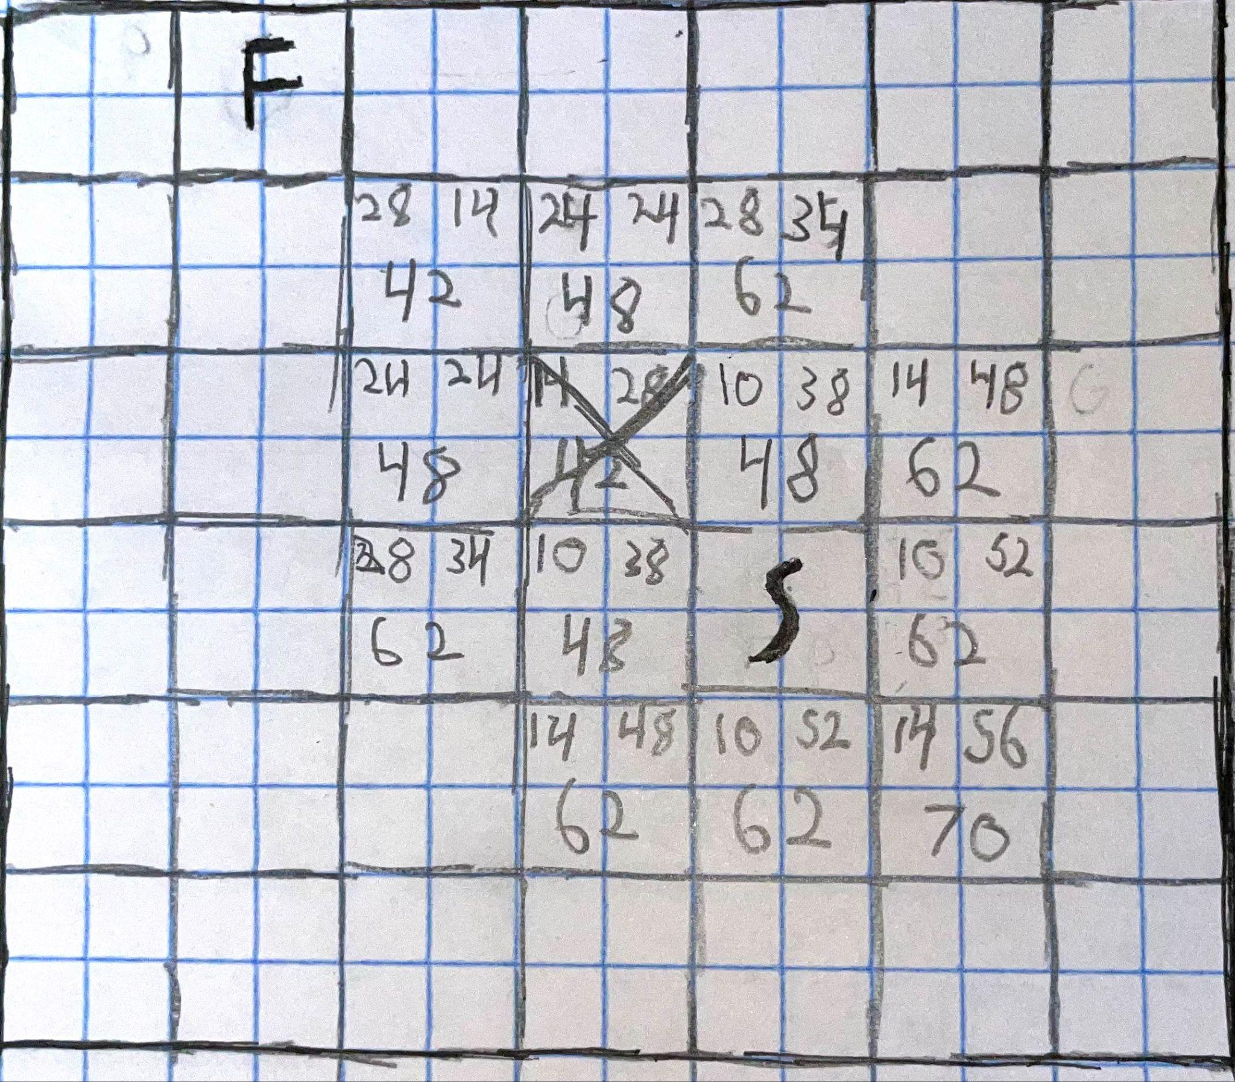
Damien

Slide 11
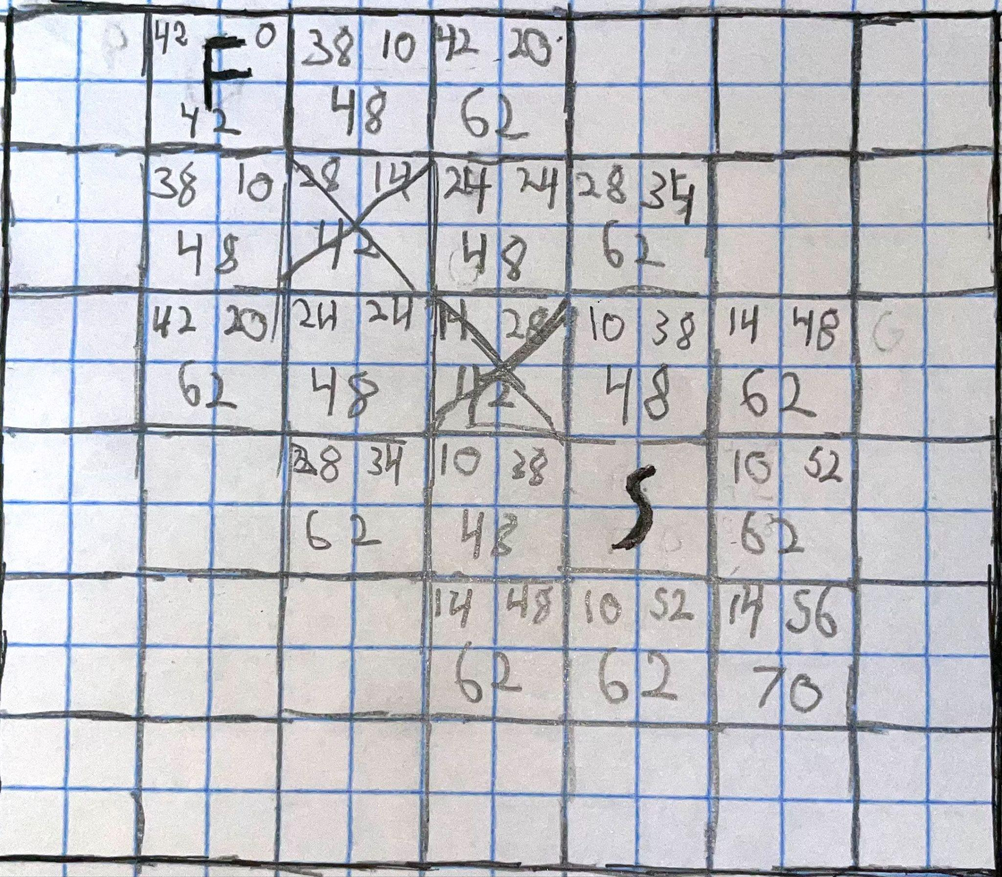
Damien

Slide 12

Demo Time
Hongxi

Slide 13
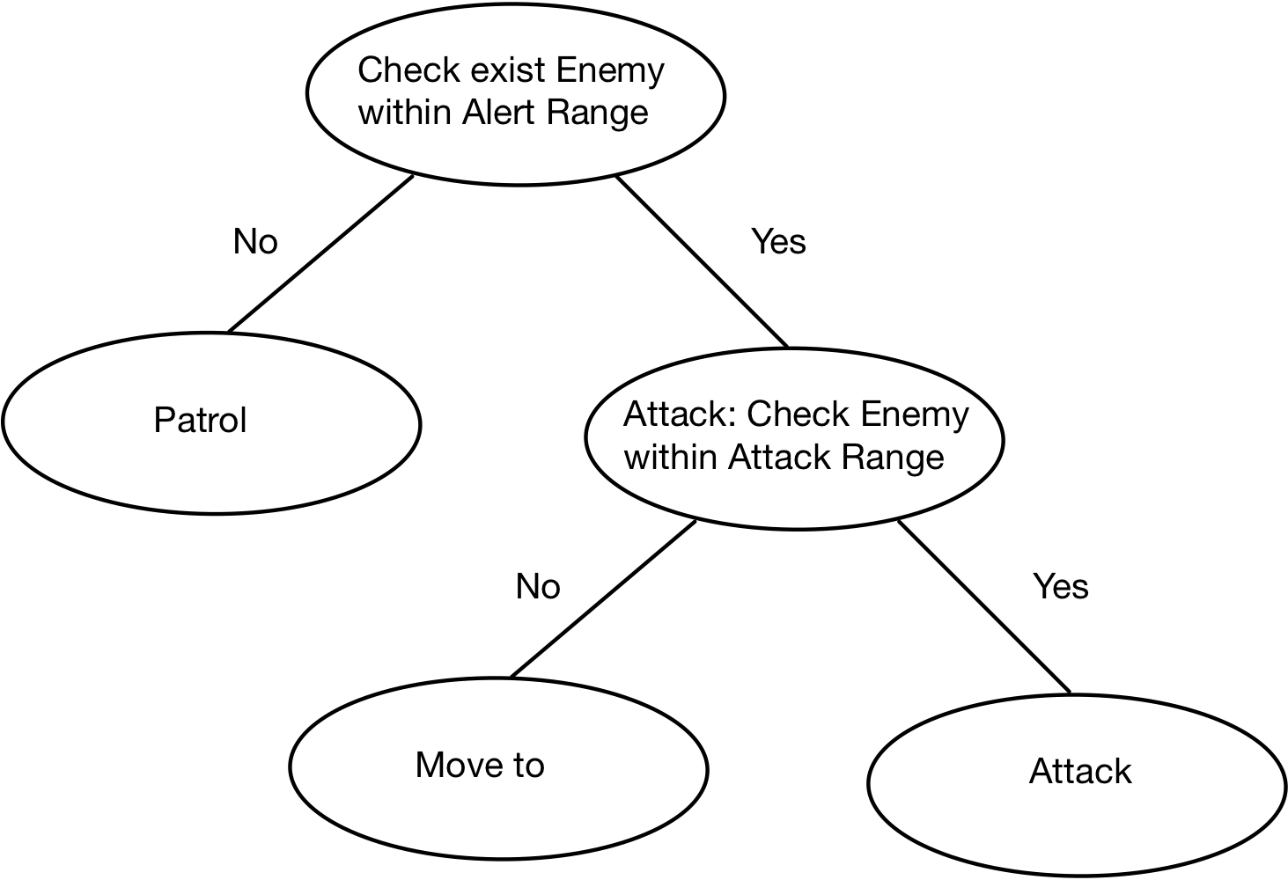
Decision Tree
Hongxi

Slide 14
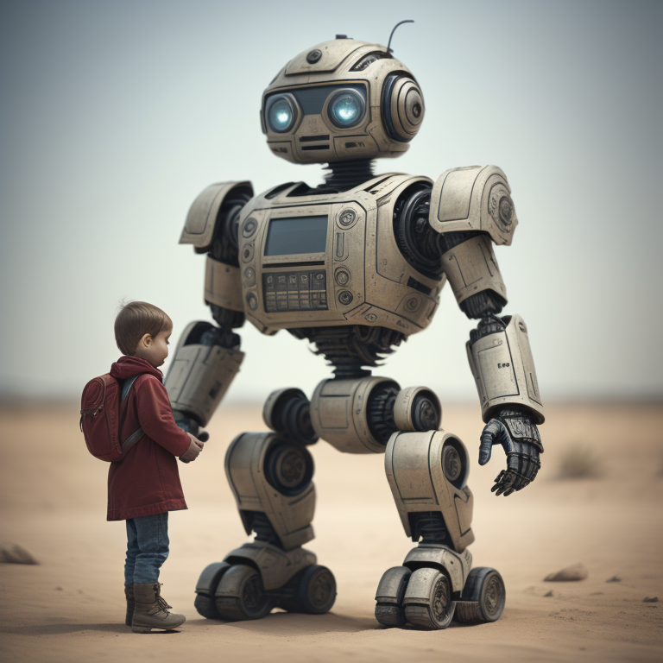


Machine Learning - Overview
ALEX
Supervised Learning
Unsupervised Learning
Reinforcement Learning

Slide 15
Machine Learning - Supervised Learning
ALEX
In supervised learning, the algorithm is trained on a labeled dataset, where it learns to predict the output from the input data. Common algorithms include linear regression, decision trees, support vector machines, and neural networks.
WE WILL LOOK AT A NEURAL NETWORK
EXAMPLE LATER!

Slide 16
Supervised Learning Example - NEAT
ALEX
NeuroEvolution of Augmenting Topologies
Kenneth O. Stanley in 2002
Category: Evolving artificial neural networks (ANNs)
Mutation and Crossover Operations

Slide 17
NEAT EXAMPLE - MARI/O
ALEX
Notes:
Created by Seth Hendrickson in 2015 (Sethbling) who is commonly known for old minecraft redstone videos as well as super mario world speedrunning.

Slide 18

NEAT MAR/IO - Notable Species
ALEX
Species 19 - First Species to Chargin’ Chuck
Species 14 - Second Species to Chargin’ Chuck
Species 30-32 - Learned to crouch everywhere?
Species 5 - Also evolved to crouch everywhere
Generation 42, Species 10, Genome 4 BEAT IT
Notes:
3201 fitness plateau

Slide 19
Machine Learning - Unsupervised Learning
ALEX
Unsupervised learning involves training the algorithm on an unlabeled dataset, where the algorithm tries to learn the patterns and relationships within the data. Clustering and dimensionality reduction are common tasks associated with unsupervised learning. Algorithms include k-means clustering, hierarchical clustering, and principal component analysis. CHATGPT USES UNSUPERVISED LEARNING

Slide 20
Unsupervised Learning Example - GPT
ALEX
ChatGPT is the most well known GPT model
Generative Pre-trained Transformer
Large-scale unsupervised learning approach, which enables it to capture the statistical regularities and patterns in the data without explicit task-specific supervision. (Curated, but not supervised)
Notes:
ChatGPT utilizes a variant of the transformer architecture, which is a deep learning model designed for natural language processing (NLP) tasks. The transformer architecture has proven to be highly effective for tasks such as language generation, translation, and understanding.
GPT-3.5 is pre-trained on a diverse dataset that includes a wide range of texts from various sources, allowing it to understand and generate human-like text across multiple domains. It uses a large-scale unsupervised learning approach, which enables it to capture the statistical regularities and patterns in the data without explicit task-specific supervision (From ChatGPT)

Slide 21
GPT EXAMPLE - CHATGPT
ALEX

Slide 22
GPT - GPT 4 Changes
ALEX
Enhanced Contextual Understanding
Ethical and Bias Mitigation
Multimodal Capabilities
Notes:
ChatGPT utilizes a variant of the transformer architecture, which is a deep learning model designed for natural language processing (NLP) tasks. The transformer architecture has proven to be highly effective for tasks such as language generation, translation, and understanding.
GPT-3.5 is pre-trained on a diverse dataset that includes a wide range of texts from various sources, allowing it to understand and generate human-like text across multiple domains. It uses a large-scale unsupervised learning approach, which enables it to capture the statistical regularities and patterns in the data without explicit task-specific supervision (From ChatGPT)

Slide 23
Machine Learning - Reinforcement Learning
ALEX
Reinforcement learning involves training an agent to make decisions in an environment in order to maximize some notion of cumulative reward. It learns from a system of rewards and punishments without any explicit guidance. Some common algorithms include Q-learning, deep Q-networks, and policy gradients.

Slide 24
Reinforcement Learning - Boston Dynamics
ALEX
Not well documented on the method
Atlas Robot
Actors learn optimal “State-Action” Values and are rewarded

Slide 25
RL EXAMPLE - ATLAS
ALEX

Slide 26
Ethical principles of AI
Public
Client and Employer
Product
Judgement
Management
Profession
Colleagues
Self
Hongxi

Slide 27
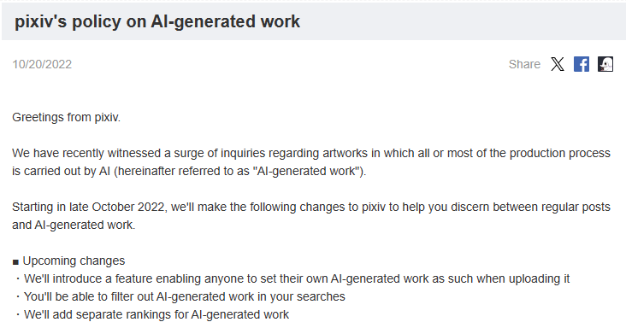
Some News about AI
Hongxi

Slide 28
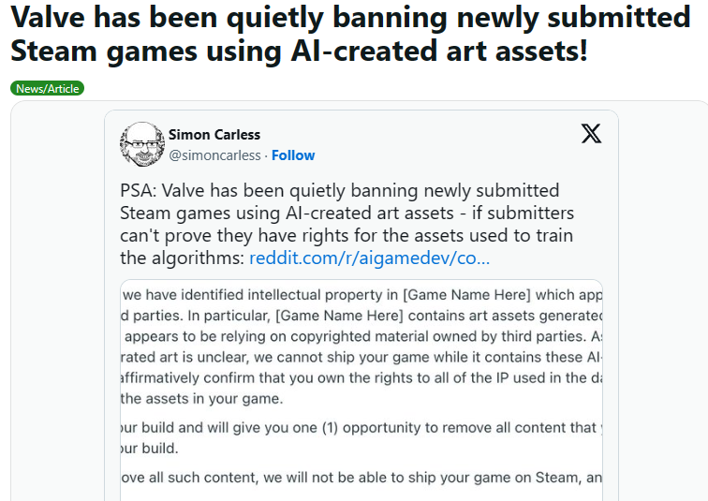
Some News about AI
Hongxi

Slide 29
Public, Client and Employer, Profession
Public: Software engineers shall act consistently with the public interest.
Client and Employer: Software engineers shall act in a manner that is in the best interests of their client and employer consistent with the public interest.
PROFESSION - Software engineers shall advance the integrity and reputation of the profession consistent with the public interest.
Hongxi

Slide 30
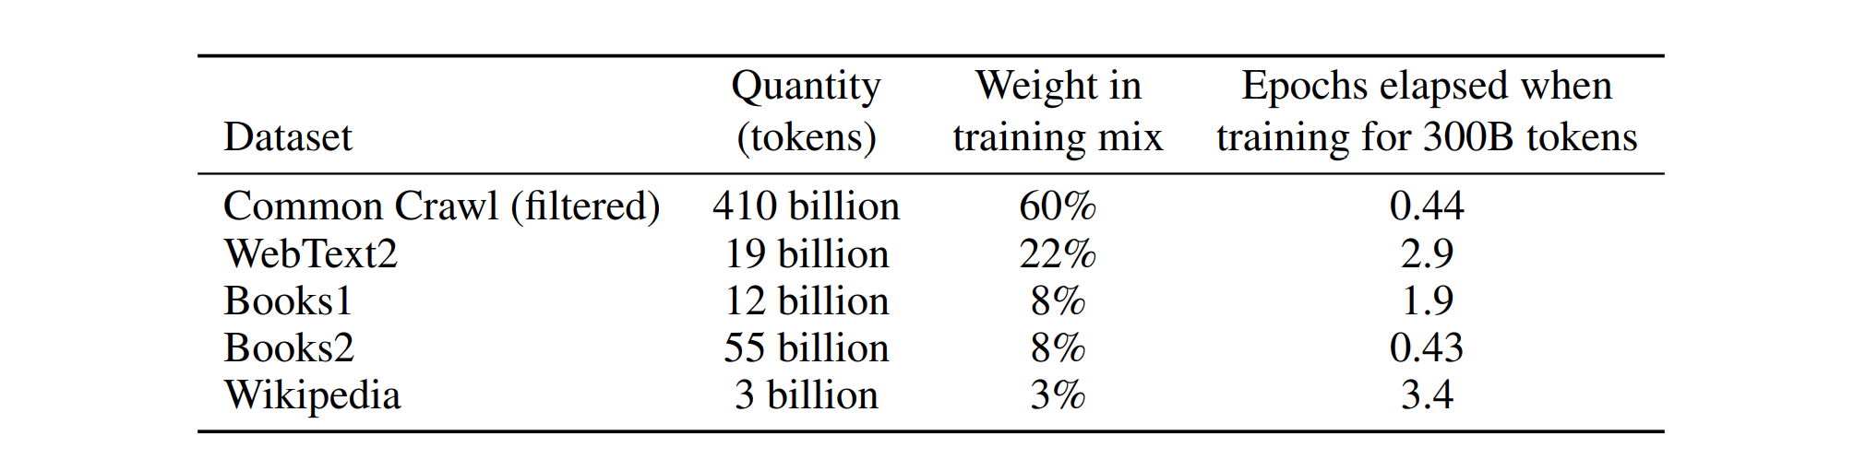
Data amount for training GPT4
410 billion tokens
About 300 billion words
About 3.1 billion web pages
About 320TB of text information
Hongxi

Slide 31
Product, Management, Self
PRODUCT - Software engineers shall ensure that their products and related modifications meet the highest professional standards possible.
MANAGEMENT - Software engineering managers and leaders shall subscribe to and promote an ethical approach to the management of software development and maintenance.
SELF - Software engineers shall participate in lifelong learning regarding the practice of their profession and shall promote an ethical approach to the practice of the profession.
Hongxi

Slide 32
Judgement, Colleagues
JUDGMENT - Software engineers shall maintain integrity and independence in their professional judgment.
COLLEAGUES - Software engineers shall be fair to and supportive of their colleagues.
Hongxi

Slide 33
Alert!
The Eight Principles are need to know for ethics quiz!
Hongxi

Slide 34
Thanks!
Damien, Hongxi and Alex

Slide 35
Sources
https://theory.stanford.edu/~amitp/GameProgramming/AStarComparison.html#:~:text=A*%20is%20the%20most%20popular,a%20heuristic%20to%20guide%20itself.
https://www.ibm.com/topics/artificial-intelligence
[pixiv] Announcements - pixiv's policy on AI-generated work
Valve has been quietly banning newly submitted Steam games using AI-created art assets! : r/pcmasterrace (reddit.com)
ChatGPT 的训练集来自哪里？ - 知乎 (zhihu.com)

